Slide 1
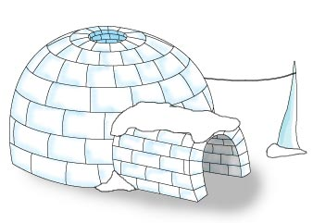

Castle Igloo
2006/2007
Licence Apache 2.0
Castle.Igloo

Slide 2
Castle Igloo Basics
Pre-require
Concept
Scopes
PageFlow
Configuration
Controller
View
Exemple
Castle.Igloo

Slide 3
Concepts
An "MVC" framework for Asp.NET
Manages Flow page
Manages typed user context support
Injection of Controller in UI element (Page, User control, MasterPage)
Transparent integration in Asp.Net
Testable controller
Multiple scope component (Session, request, page, application, custom, conversation [In progress])
Castle.Igloo

Slide 4
Pre-Require
It’s only .NET 2.0
You need to install the Web Application Projects which comes back once again to default in VS 2005 Service Pack 1.
Castle.Igloo dll
Castle.Igloo

Slide 5
Scopes
Page 1
Page X
Page X
Page X
Page
Page
Page
Request Scope
Conversation Scope
Page Scope
Session Scope
Application Scope
Scope Web context
Singleton Scope
Thread Scope
Transient Scope
Custom Scope
Castle.Igloo

Slide 6
Scopes
Application Scope : Scopes a single component definition to the lifecycle of an ASP.NET application.
Conversation Scope : Scope conversation provides fine grain control over the session scope so that "concurrent conversations" can occur.
Page Scope : Scopes a single component model to the lifecycle of a aspx page.
Request Scope : Scopes a single component model to the lifecycle of a single HTTP request;
Session Scope : Scopes a single component model to the lifecycle of a HTTP Session.
Singleton Scope : Scopes a single component model to a single object instance per Castle IoC container.
Transient Scope : Scopes a single component model to any number of object instances.
Thread Scope : Scopes a single component model to the lifecycle of a thread
Castle.Igloo

Slide 7
Scope notion
Component wiring (dependency injection) is performed when an IOC managed component are instantiated, which means that, a component in a wide scope (such as singleton) cannot have a reference to a component in a narrow scope (the request/session ..., for examples).
To fixes this problem you must always created and injected a proxy component for every reference of a narrow scoped component.
This proxy component exposes the same public interface as the scoped component but it will be able to determine the real, target object from the relevant (request/session...) scope and delegate method calls onto this real object. This proxy will be created by Igloo.
Requirement for proxy component in a scope are made when configuring component (next slide)
All scope implement the IScope interface and you can implement your own scope.
Such custom scope are referenced as others components in the configuration file.
Castle.Igloo

Slide 8

Component scoping
Via XML configuration (scope attribute on component tag)
Via .NET Attribute on component class
Castle.Igloo

Slide 9
View
UI element must derive from Castle.Igloo.UI.Web.Page, Castle.Igloo.UI.Web. MasterPage,
Castle.Igloo.UI.Web. UserControl
to support Controller injection
Castle.Igloo

Slide 10
Controller
Must derive from base class : Castle.Igloo.Controllers.BaseController
Are Request scope by default (via heritage)
Castle.Igloo

Slide 11
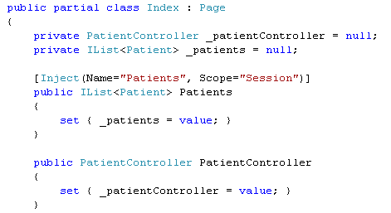
State user management
Provides safe, intuitive user state management
[Inject(ScopeName)] attribute specifies that a state value should be
Castle.Igloo

Slide 12


Inject Attribute
Name : The scope variable name. Defaults to the name of the annotated field or getter method.(Not required)
Scope :Explicitly specify the scope to search, instead of searching all scopes.(Not required)
Create : Specifies that a object should be instantiated if the scope variable is null.
Castle.Igloo

Slide 13

Navigation
The NavigationState contains data for processing navigation.
NavigationState can be accessed on Controller
SkipNavigation attribute specifies that a controller method must not declench a navigation to another view.
Castle.Igloo

Slide 14
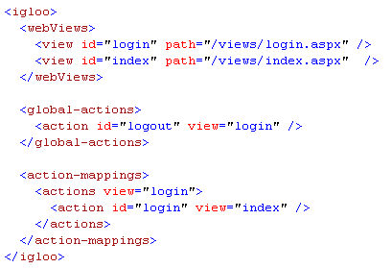
Page Flow
Action is alimented from the ‘commandName’ attribute of UI control (Button..) or can been via code
Castle.Igloo

Slide 15
Exemple : Page Flow configuration
Navigation flow are automatically done after a call of a controller’s method via an interceptor and so each controller method must be declare as Virtual.
Castle.Igloo

Slide 16
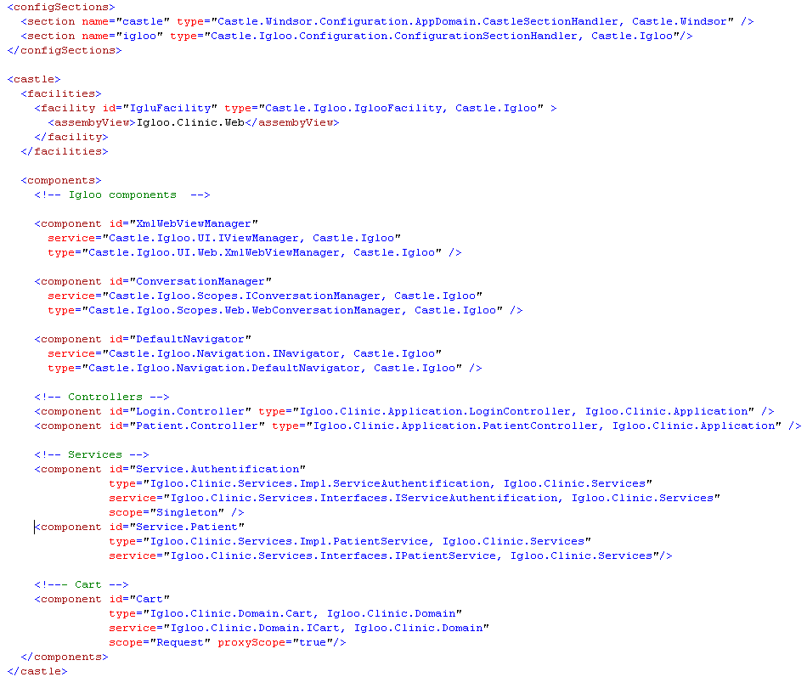
Exemple : IOC Configuration
Castle.Igloo

Slide 17
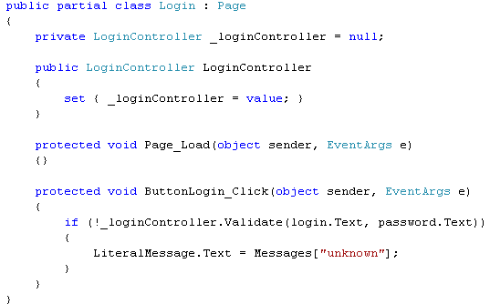
Exemple : Login Page
Setter injection
Login Page
Castle.Igloo

Slide 18
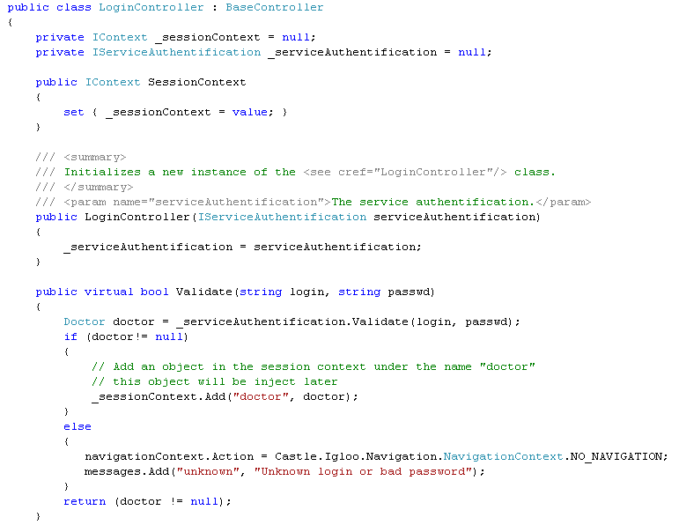
Exemple : Login Controller
IOC injection
User state
management
Navigation
management
+
Flash message
Castle.Igloo

Slide 19
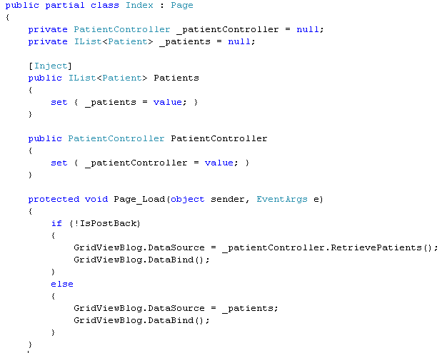
Exemple : 2nd page
User state
injection
Setter injection
Castle.Igloo

Slide 20
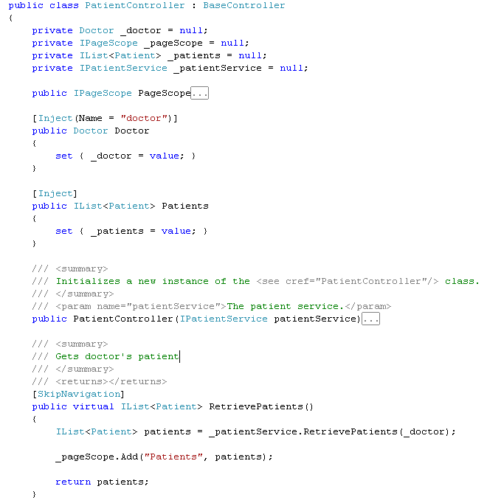
Exemple : Patient Controller
IOC injection
User state
injection
User state
injection
Navigation
management
User state
management
Castle.Igloo

